Slide 1
Occupational Studies
Art
Specialist crafts is a two-year course
Yr11: FABRIC PRINTING
Yr12: Textile and Fashion Design

Slide 2
Assessment 100% Coursework
Both modules assessed through individual portfolios. For each module, the portfolio is divided into the following three sections.
AO1 (Knowledge & Understanding)
In this section, pupils will undertake a number of tasks that will assess their knowledge on health and safety, careers, environmental issues and knowledge on materials and related skills.
AO2 (Application of Knowledge and Skills)
This section is comprised of photographic evidence of student work during their tasks. Tasks comprise of researching artist work, developing ideas, written proposal, creating craft items, exhibiting work and peer evaluations.
AO3 (Evaluation /Diary input)
This section is made up with evaluations from set tasks and final entries.

Slide 3
Year 11
Specialist crafts: fabric Printing
This unit provides learners with some of the basic health and safety knowledge required by the textile industry and the careers that will become available.
Pupils will also design & create artwork from each of the following disciplines
Polystyrene printing
Mono printing
Lino printing
Embroidery
Pupils will be given a design brief. Pupils must research, design, develop and create a craft item.

Slide 4



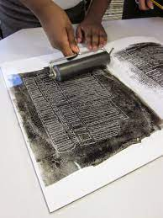

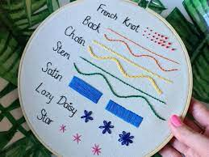
MONO PRINTING
LINO PRINTING
EMBROIDERY
POLYSTRENE PRINTING

Slide 5

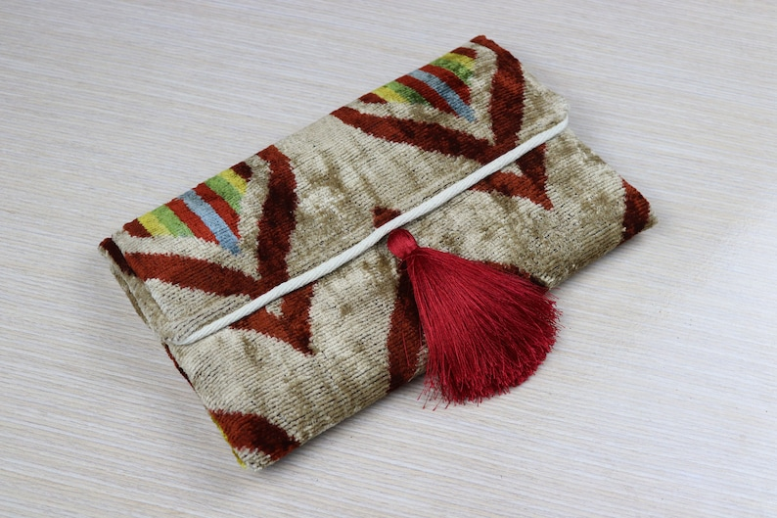
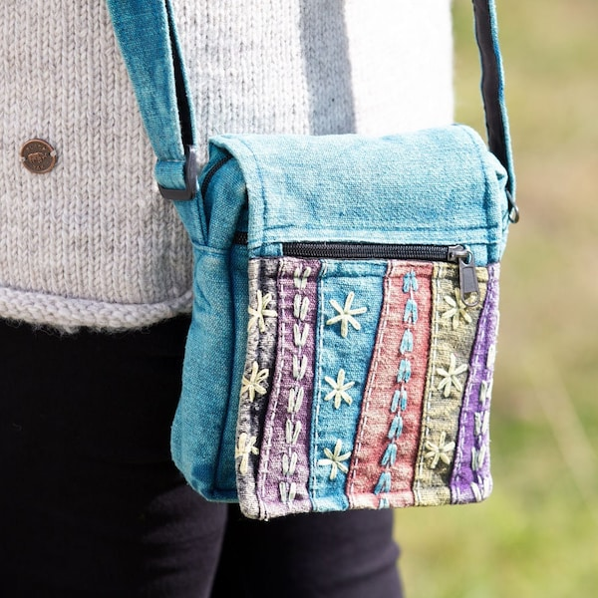

YEAR 12
Textile and Fashion Design
SECTION 1:
Provides learners with some of the basic health and safety knowledge required by the FASHION industry and the careers that will become available.
SECTION 2:
Pupils will learn about the tools for making and creating a fashion garment.
SECTION 3:
Pupils will be given a design brief. Pupils must research, design, develop and create a FASHION item.

Slide 6
OVERVIEW
Occupational studies Art
If you are dedicated, creative and enthusiastic person who is willing to try new skills and work hard then this is the course for you.
Any other queries please email
Mrs A Hill
ahill444@c2ken.net

